Slide 1

Title of the Project/Thesis
by
Student Name 4
Roll No. 214G1A32XX
Student Name 2
Roll No. 214G1A32XX
Student Name 1
Roll No. 214G1A32XX
Student Name 3
Roll No. 214G1A32XX
Under the guidance of
^{Mr. Xyz} M. Tech.
Assistant Professor
Department of Computer Science and Engineering (AI & ML)
Srinivasa Ramanujan Institute of Technology
(Affiliated to JNTUA & Approved by AICTE) (Accredited by NAAC with ‘A’ Grade & Accredited by NBA (EEE, ECE & CSE)
Rotarypuram Village, B K Samudram Mandal, Ananthapuramu – 515701.
2025 - 2026
Srinivasa Ramanujan Institute of Technology

Slide 2
Abstract
The context or background information for your research The general topic and specific research question or problem The main objectives and goals of your research
The methods you used to conduct your research The results or findings of your research
The conclusions or implications of your research
Note : The above points should be specified in an abstract using paragraphs mostly 1.
Srinivasa Ramanujan Institute of Technology

Slide 3
Contents
Title of Project
Abstract
Introduction
Literature survey
Proposed Work
References
GitHub Link
Queries
Srinivasa Ramanujan Institute of Technology
3

Slide 4
Introduction
Title of Project
Point 1
Point 2
Point 3
Point 4
Point 5
Point n
Srinivasa Ramanujan Institute of Technology

Slide 5
Literature Survey
Title of Project
No | Title | Author | Journal Name & Year | Methodology Adapted | Key Findings | Gaps
1. | Deep Recurrent Neural Networks for Human Activity Recognistion | A. Murad, JyPun | Sensors, Research Gate Journal & 2017 | Deep Learning Techniques | Deep Recurrent Neural Network based Unidirectional | Exploring these models on a diverse datasets
2
3
4
5
Srinivasa Ramanujan Institute of Technology

Slide 6
Proposed System
Title of Project
Point 1
Point 2
Point 3
Point 4
Point 5
Point n
Srinivasa Ramanujan Institute of Technology

Slide 7
Reference
Title of Project
[1]. Author 1, Author 2 and Author 3, “Title of the Paper”,” Journal name where the paper published, vol. 11, pp. 11-15, Jan. 2020.
Use Mendeley software
Srinivasa Ramanujan Institute of Technology

Slide 8
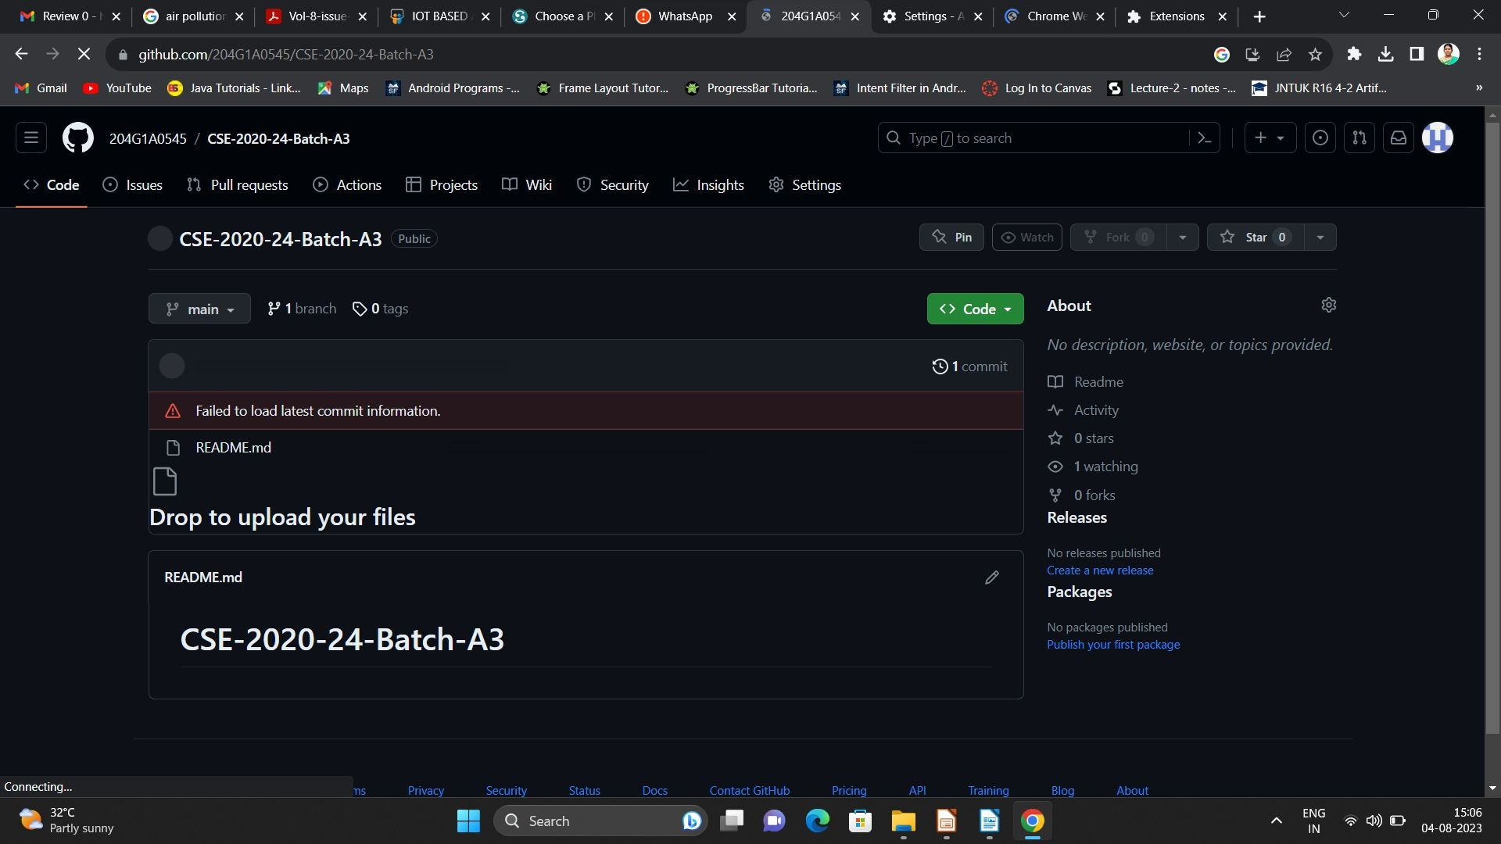
Git Hub Dashboards of each student
Title of Project
Repository Name Like: CSM 2025 – 26 Batch: A – XX
Under that project data upload literature survey papers, and son on..
Srinivasa Ramanujan Institute of Technology

Slide 9
Any Queries?
Title of Project
Srinivasa Ramanujan Institute of Technology

Slide 10
Thank You!!!
Title of Project
Srinivasa Ramanujan Institute of Technology

